Slide 2
A01_MQT
All loadcase summary
1. Static load cases |  | OK | NOK | Remark
1.1 Radial elasticity: At steering wheel hub: 600 N in Z-direction or 250 N in Y-direction (local coordinate system) | 1.1.1 Steering column on rigid plate | X
 | 1.1.2 MQT with steering column in rigid frame | X
 | 1.1.3 MQT with steering column in body | X
1.2 Deflection: Load at center of MQT | 1.2.1 MQT with steering column in rigid frame, bolts not tightened |  |  | The center of MQT is deformed 1mm when loaded 125N.
1.3 Static stiffness of the bolt-on points | 1.3.1 Body-in-white
 | 1.3.2 MQT in rigid frame | X
2. Dynamic load cases |  | OK | NOK | Remark
2.1 Natural frequencies and mode shapes | 2.1.1 Steering column on rigid plate |  |  | The 1st global modal is 60.981Hz.
 | 2.1.2 MQT with steering column in rigid frame |  |  | The 1st global modal is 45.778Hz.
 | 2.1.3 MQT with steering column in body |  |  | The 5th local Modal is 37.962Hz.

Slide 3
A01_MQT
Boundary condition & Load case 1.1.1 review
1.1.1 Radial elasticity: Steering column on rigid plate
Loading Force:-Z=600N,-Y=250N
Loading Direction: Normal
Temperature: 23℃
Target:-Z=600N,Displacement<2.4mm
-Y=250N,Displacement<1.5mm
Bound the bolt-on points between car cross beam and steering column

Slide 4
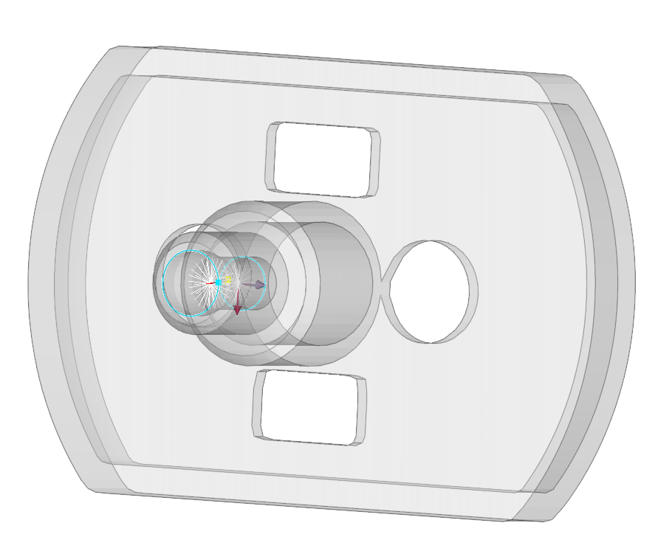
A01_MQT
1.1.1 Radial elasticity: Steering column on rigid plate results overview
Load case | Force | Target | CAE Result | Status
1.1.1 Radial elasticity: Steering column on rigid plate | -Z600N | Dis<2.4mm | 0.76mm | OK
 | -Y250N | Dis<1.5mm | 0.29mm | OK
-Y=250N
-Z=600N
The radial elasticity at steering wheel hub can meet the target.

Slide 5
A01_MQT
Boundary condition & Load case 1.1.2 review
1.1.2 Radial elasticity: MQT with steering column in rigid frame
Loading Force:-Z=600N,-Y=250N
Loading Direction: Normal
Temperature: 23℃
Target:-Z=600N,Displacement<2.4mm
-Y=250N,Displacement<1.5mm
Bound the bolt-on points between car cross beam and BIW

Slide 6
A01_MQT
1.1.2 Radial elasticity: MQT with steering column in rigid frame results overview
Load case | Force | Target | CAE Result | Status
1.1.2 Radial elasticity: MQT with steering column in rigid frame | -Z600N | Dis<2.4mm | 1.53mm | OK
 | -Y250N | Dis<1.5mm | 0.39mm | OK
The radial elasticity at steering wheel hub can meet the target.

Slide 7
A01_MQT
Boundary condition & Load case 1.1.3 review
1.1.3 Radial elasticity: MQT with steering column in body
Loading Force:-Z=600N,-Y=250N
Loading Direction: Normal
Temperature: 23℃
Target:-Z=600N,Displacement<2.4mm
-Y=250N,Displacement<1.5mm
-Y=250N
-Z=600N
Bound the bolt-on points between BIW and suspension

Slide 8
A01_MQT
1.1.3 Radial elasticity: MQT with steering column in body results overview
Load case | Force | Target | CAE Result | Status
1.1.3 Radial elasticity: MQT with steering column in body | -Z600N | Dis<2.4mm | 2.06mm | OK
 | -Y250N | Dis<1.5mm | 0.55mm | OK
-Y=250N
-Z=600N
The radial elasticity of –Z600N at steering wheel hub can meet the target.

Slide 9
A01_MQT
Boundary condition & Load case 1.2.1 review
1.2.1 Deflection: Load at center of MQT
Loading Displacement:-Z=1mm
Loading Direction: Normal
Temperature: 23℃
Target: Force>110N
Constrain d.o.f 12356 on the bolt-on points between car cross beam and BIW

Slide 10
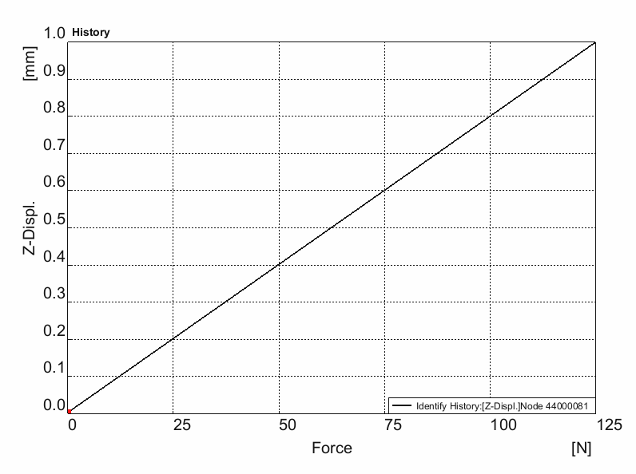
A01_MQT
1.2.1 Steering column on rigid plate
Result in detail
Force = 125N
The center of MQT is deformed 1mm when loaded 125N.

Slide 11
A01_MQT
Boundary condition & Load case 1.3.1 review
1.3.1 Static stiffness of the bolt-on points: Body-in-white
Loading Force:-X/-Y/-Z=1000N
Loading Direction: Local
Temperature: 23℃

Slide 12
A01_MQT
1.3.1 Static stiffness of the bolt-on points: Body-in-white results overview
No. | Force | Target | CAE Result |  |  | Status
 |  |  | X(mm) | Y(mm) | Z(mm)
1 | 1000N | Displacement: TBD | 0.24 | 0.32 | 0.02 | /
2 |  |  | 0.25 | 0.26 | 0.01
3 |  |  | 0.25 | 0.26 | 0.01
4 |  |  | 0.25 | 0.32 | 0.02
5 |  |  | 0.91 | 0.09 | 0.27
6 |  |  | 0.81 | 0.14 | 0.17
7 |  |  | 0.21 | 0.02 | 0.25
8 |  |  | 0.21 | 0.02 | 0.27
9 |  |  | 0.19 | 0.02 | 0.27
10 |  |  | 0.20 | 0.02 | 0.25
The target need to be determined after internal discussion.

Slide 13
A01_MQT
Boundary condition & Load case 1.3.2 review
1.3.2 Static stiffness of the bolt-on points: MQT in rigid frame
Loading Force:-X/-Y/-Z=150N
Loading Direction: Local
Temperature: 23℃
Target: Sfast_x: ≤ 1.5mm
Stran: ≤ 3.0mm
Sunload: ≤0.5mm

Slide 14
A01_MQT
1.3.2 Static stiffness of the bolt-on points: MQT in rigid frame results overview
Point number | CAE Result |  |  |  |  |  | Status
 | 150N
 | Sfast_x | Sunload_x | Stran1_y | Sunload_y | Stran2_z | Sunload_z
 | Dis≤1.5mm | Dis≤0.5mm | Dis≤3.0mm | Dis≤0.5mm | Dis≤3.0mm | Dis≤0.5mm
A1 | 0.18mm | 0.00mm | 0.07mm | 0.00mm | 0.15mm | 0.00mm | OK
A2 | 0.02mm | 0.00mm | 0.01mm | 0.00mm | 0.04mm | 0.00mm | OK
A3 | 0.02mm | 0.00mm | 0.01mm | 0.00mm | 0.03mm | 0.00mm | OK
A4 | 0.06mm | 0.00mm | 0.07mm | 0.00mm | 0.13mm | 0.00mm | OK
A5 | 0.76mm | 0.00mm | 0.12mm | 0.00mm | 0.54mm | 0.00mm | OK
A6 | 0.28mm | 0.00mm | 0.12mm | 0.00mm | 0.25mm | 0.00mm | OK
A7 | 0.31mm | 0.00mm | 0.05mm | 0.00mm | 0.10mm | 0.00mm | OK
A8 | 0.37mm | 0.00mm | 0.03mm | 0.00mm | 0.13mm | 0.00mm | OK
A9 | 0.42mm | 0.00mm | 0.07mm | 0.00mm | 0.18mm | 0.00mm | OK
A10 | 0.33mm | 0.00mm | 0.15mm | 0.00mm | 0.59mm | 0.00mm | OK
All points can meet the target.

Slide 15
A01_MQT
1.3.2 Static stiffness of the bolt-on points: MQT in rigid frame results overview
Point number | CAE Result |  |  |  |  |  | Status
 | 150N
 | Sfast_x | Sunload_x | Stran1_y | Sunload_y | Stran2_z | Sunload_z
 | Dis≤1.5mm | Dis≤0.5mm | Dis≤3.0mm | Dis≤0.5mm | Dis≤3.0mm | Dis≤0.5mm
A11 | 0.22mm | 0.00mm | 0.09mm | 0.00mm | 0.17mm | 0.00mm | OK
A12 | 0.04mm | 0.00mm | 0.10mm | 0.00mm | 0.03mm | 0.00mm | OK
A13 | 0.32mm | 0.00mm | 0.03mm | 0.00mm | 0.03mm | 0.00mm | OK
A14 | 0.63mm | 0.00mm | 0.16mm | 0.00mm | 0.22mm | 0.00mm | OK
A15 | 0.28mm | 0.00mm | 0.05mm | 0.00mm | 0.03mm | 0.00mm | OK
A16 | 0.29mm | 0.00mm | 0.06mm | 0.00mm | 0.07mm | 0.00mm | OK
A17 | 0.88mm | 0.00mm | 0.14mm | 0.00mm | 1.34mm | 0.00mm | OK
A18 | 0.28mm | 0.00mm | 0.09mm | 0.00mm | 0.05mm | 0.00mm | OK
A19 | 0.12mm | 0.00mm | 0.08mm | 0.00mm | 0.13mm | 0.00mm | OK
A20 | 0.32mm | 0.00mm | 0.08mm | 0.00mm | 0.07mm | 0.00mm | OK
All points can meet the target.

Slide 16
A01_MQT
1.3.2 Static stiffness of the bolt-on points: MQT in rigid frame results overview
Point number | CAE Result |  |  |  |  |  | Status
 | 150N
 | Sfast_x | Sunload_x | Stran1_y | Sunload_y | Stran2_z | Sunload_z
 | Dis≤1.5mm | Dis≤0.5mm | Dis≤3.0mm | Dis≤0.5mm | Dis≤3.0mm | Dis≤0.5mm
B1 | 1.47mm | 0.01mm | 0.72mm | 0.00mm | 0.04mm | 0.00mm | OK
B2 | 1.33mm | 0.00mm | 0.48mm | 0.00mm | 0.05mm | 0.00mm | OK
D1 | 0.88mm | 0.00mm | 0.08mm | 0.00mm | 0.08mm | 0.00mm | OK
D2 | 0.23mm | 0.00mm | 0.07mm | 0.00mm | 0.06mm | 0.00mm | OK
D3 | 0.12mm | 0.00mm | 0.06mm | 0.00mm | 0.03mm | 0.00mm | OK
D4 | 0.10mm | 0.00mm | 0.06mm | 0.00mm | 0.05mm | 0.00mm | OK
D5 | 0.30mm | 0.00mm | 0.12mm | 0.00mm | 0.09mm | 0.00mm | OK
E1 | 1.38mm | 0.00mm | 0.15mm | 0.00mm | 2.62mm | 0.00mm | OK
F1 | 0.03mm | 0.00mm | 0.01mm | 0.00mm | 0.03mm | 0.00mm | OK
F2 | 0.05mm | 0.00mm | 0.02mm | 0.00mm | 0.02mm | 0.00mm | OK
All points can meet the target.

Slide 17
A01_MQT
1.3.2 Static stiffness of the bolt-on points: MQT NOK
in rigid frame results overview
Point number | CAE Result |  |  |  |  |  | Status
 | 150N
 | Sfast_x | Sunload_x | Stran1_y | Sunload_y | Stran2_z | Sunload_z
 | Dis≤1.5mm | Dis≤0.5mm | Dis≤3.0mm | Dis≤0.5mm | Dis≤3.0mm | Dis≤0.5mm
F3 | 0.11mm | 0.00mm | 0.02mm | 0.00mm | 0.04mm | 0.00mm | OK
F4 | 0.05mm | 0.00mm | 0.04mm | 0.00mm | 0.01mm | 0.00mm | OK
H1 | 0.08mm | 0.00mm | 0.03mm | 0.00mm | 0.03mm | 0.00mm | OK
All points can meet the target.

Slide 18
A01_MQT
Boundary condition & Load case 2.1.1 review
2.1.1 Natural frequencies and mode shapes :Steering column on rigid plate
Constrained modal analysis, based on Boundary condition.
Target:>50Hz
Bound the bolt-on points between car cross beam and steering column

Slide 19
A01_MQT
2.1.1 Natural frequencies and mode shapes :Steering column on rigid plate results overview
Modal | Frequency(Hz) | Modal | Direction
2 | 60.891 | Global | 135°
3 | 61.664 | Global | 45°
4 | 177.381 | Global | Y
5 | 203.718 | Global | Z
6 | 246.810 | Global | 45°
7 | 265.421 | Global | X
8 | 325.765 | Local | /
9 | 370.001 | Local | /
10 | 383.639 | Global | 135°

Slide 20
A01_MQT
Boundary condition & Load case 2.1.2 review
2.1.2 Natural frequencies and mode shapes : MQT with steering column in rigid frame
Constrained modal analysis, based on Boundary condition.
Target:>42Hz.
Bound the bolt-on points between car cross beam and BIW

Slide 21
A01_MQT
2.1.2 Natural frequencies and mode shapes : MQT with steering column in rigid frame results overview
Modal | Frequency(Hz) | Modal | Direction
1 | 0.158 | Local | /
2 | 45.778 | Global | Z
3 | 55.650 | Global | Y
4 | 106.902 | Local | /
5 | 126.202 | Global | X
6 | 136.858 | Local | /
7 | 157.718 | Local | /
8 | 174.445 | Local | /
9 | 181.389 | Local | /
10 | 190.201 | Global | 180°

Slide 22
A01_MQT
Boundary condition & Load case 2.1.3 review
2.1.3 Natural frequencies and mode shapes : MQT with steering column in body
Constrained modal analysis, based on Boundary condition.
Target:>36Hz.
Bound the bolt-on points between BIW and Suspension

Slide 23
A01_MQT
2.1.3 Natural frequencies and mode shapes : MQT with steering column in body results overview
Modal | Frequency(Hz) | Modal | Direction
 |  |  | /
 |  |  | /
 |  |  | /
 |  |  | /
5 | 37.962 | Local | Z
6 | 40.287 | Global | 135°
7 | 44.673 | Global | 45°
8 | 46.760 | Local | Y
9 | 48.771 | Local(Rear bumper bracket) | 45°
10 | 51.715 | Global | /

